Slide 1



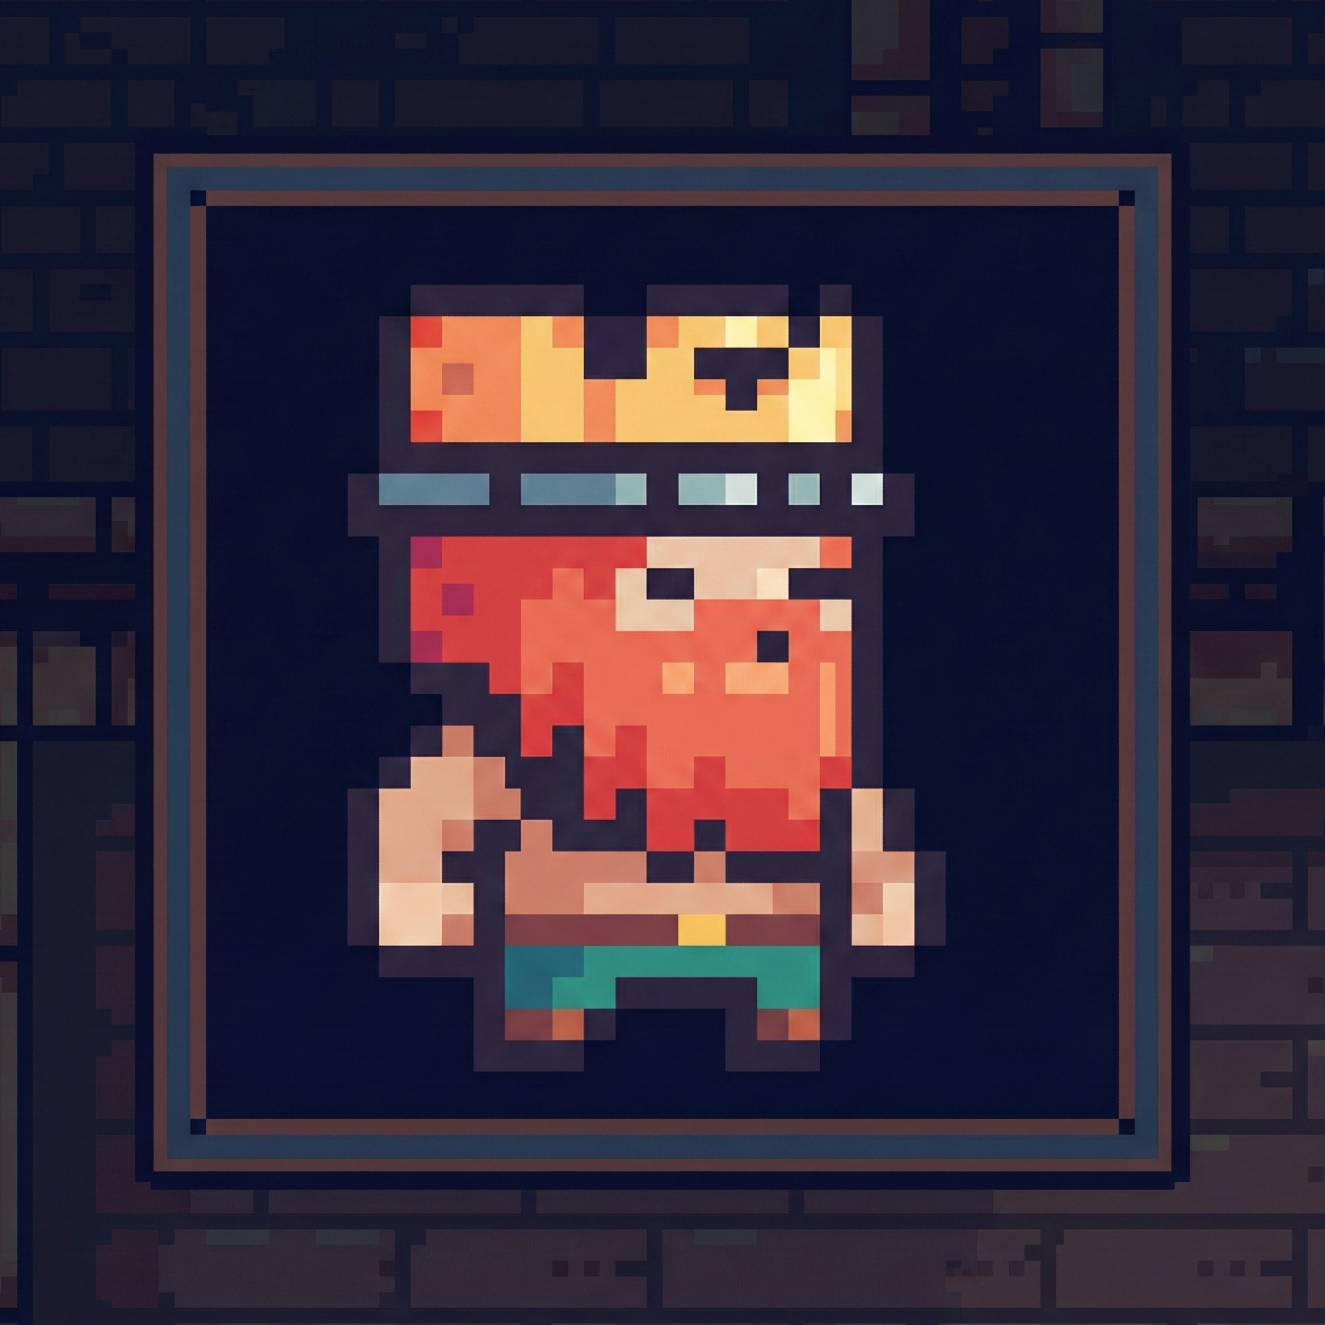
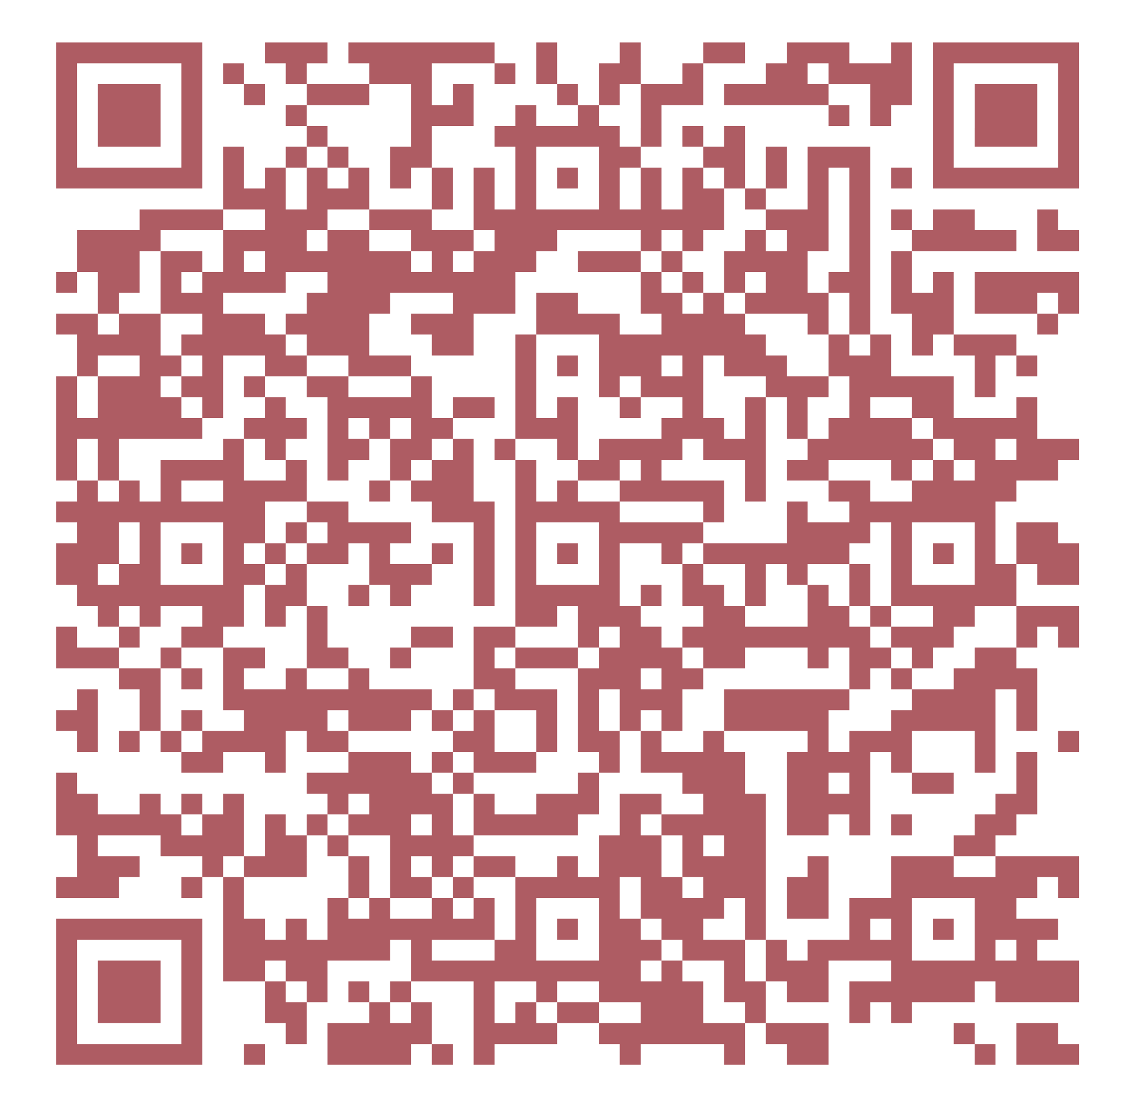
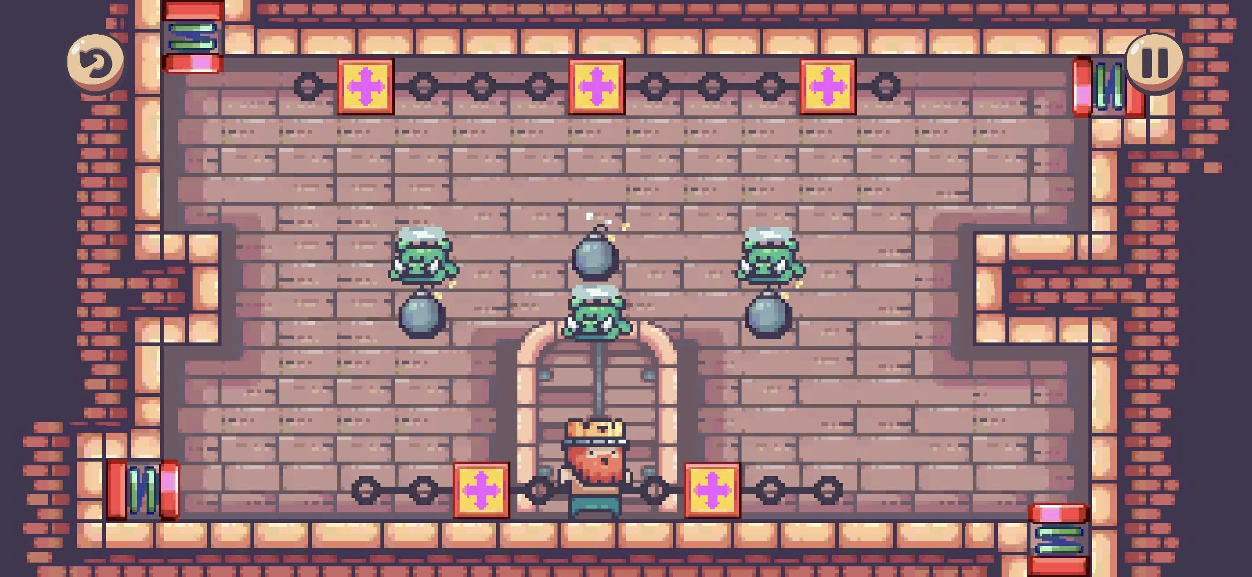
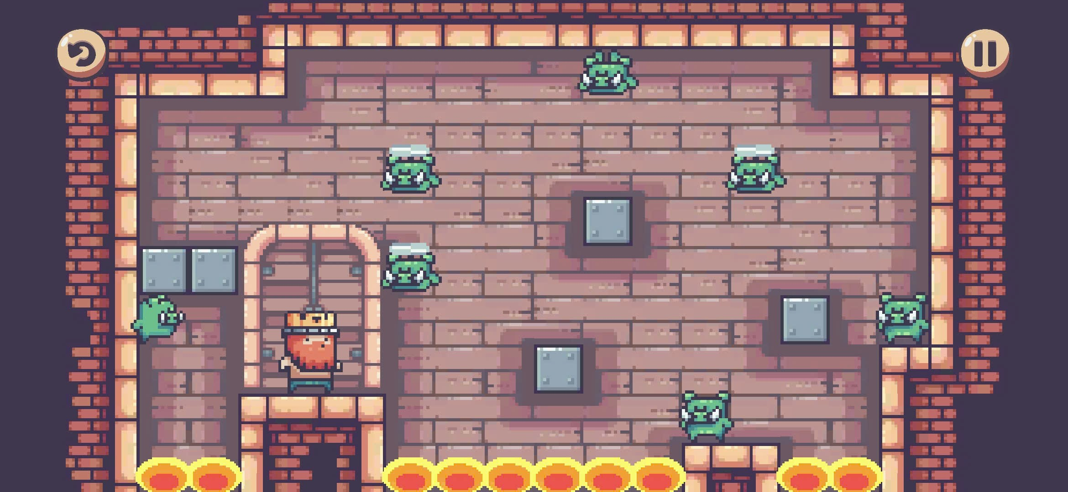
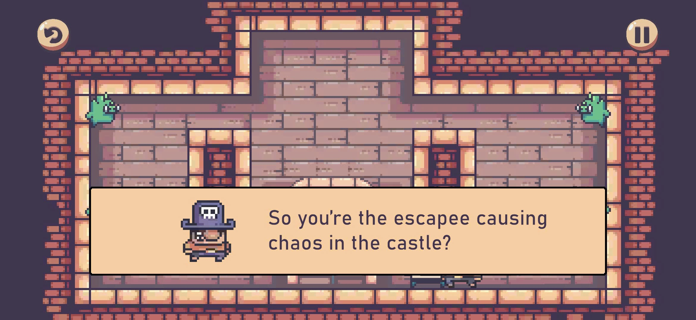

TRƯỜNG ĐẠI HỌC CÔNG NGHỆ THÔNG TIN
KHOA CÔNG NGHỆ PHẦN MỀM
SEAPP 2025
PRISON OF THE KING
Author: Nguyen Gia Hung
Email: 24520604@gm.uit.edu.vn
Prison of the King is a tactical grid-based puzzle game woven with a dark, mysterious narrative. You represent a prison escapee, fighting to break out of a heavily guarded dungeon.
Your mission: eliminate the wardens, secure the key, and find your way to freedom. Yet, every battle brings you closer to a hidden truth – secrets about the King, the castle, and your own forgotten identity.
DOWNLOAD FOR FREE
Feature
🧠 Tactical Grid Mastery Calculate precise movement graphs to outmaneuver enemies and reach the exit
💣 Dynamic Trap Mechanics Master diverse interactions like springs, bombs, barrels, slippery ice,...
🌏 Bilingual Experience Instantly switch languages for a native Vietnamese or global English experience
📈 Escalating Game Challenges Face increasingly difficult levels that demand sharp logical thinking
📜 Hidden Story Defeat wardens to uncover the dark truth behind the King and the Castle
🔄 “Re-lock” System Manually reset progress to re-experience the narrative flow from any point
💾 Auto-Save Automatically tracks completion and settings, keeping data safe after updates
Future work
Engine
Continuously expanding with new complex levels, fresh mechanics, and new chapters to the mysterious story.
Redesign graphics and SFX to better reflect the mysterious narrative.
Open source: github.com/nguyenhun11/PrisonOfTheKing
Liên hệ
24520604@gm.uit.edu.vn +84 919 202 815

